Slide 1
WORDPRESS
Created by:
Ajani Anisha

Slide 2
WHAT IS WORDPRESS
What is WordPress? WordPress is open source software you can use to create a beautiful website or blog. It just may be the easiest and most flexible blogging and website content management system (CMS).

Slide 3
MULTISITE INTRODUCTION
There are 2 terminologies which we have to understand.
1) Network: refers to the entire multisite network,eg your WordPress
installation.
2) Sites: refers to one of the blogs or sites created as part of the network.

Slide 4
MULTISITE INTRODUCTION
So when I refer to your site, I don’t mean your whole network of sites, but just one of the sites on it. Each network will have a main site, which is created when you install WordPress and which will probably use the main domain for your WordPress installation: that’s still a site.

Slide 5
WHAT IS MULTISITE?
This means that by installing WordPress just once on your server, you can run as many sites as you want, and I really mean as many as you want
The great thing about Multisite is that the WordPress installation itself is almost exactly the same as a standard installation: it has the same folder structure, the same core files and the same code base.
This means that installing a Multisite network isn’t much more complicated than installing a standard WordPress site, and updating Multisite is exactly the same as updating any WordPress site.

Slide 6
WHAT IS MULTISITE?
All of your network’s themes and plugins are stored just once, no matter how many sites you use them on, meaning you’ll be using a lot less server space than if you used a separate WordPress installation for each site.
But there are some differences in three areas: in the admin screens and the way you use them, in the files in your WordPress installation, and in the database tables.

Slide 7
How the Multisite Admin Screens Are Different
When you activate Multisite, some extra screens will be added to your admin, for managing the network.
These are accessible only to the Super Admin who manages the network (that’s you) and will let you install themes and plugins and create and manage sites.
The admin screens that each site admin can access are similar to a standard WordPress site, but a couple are missing: site admins can’t install themes or plugins but can only activate those that have been installed on the network.

Slide 8
How the Multisite Files Are Different
There are two differences to the files and folders in a multisite network:
the wp-config.php and the wp-uploads folder.
The wp-config.php file will have some extra lines added which activate Multisite and tell WordPress how it’s running.
The wp-uploads folder will contain a subfolder for each site on the network, with the site’s numerical ID as its name. Files uploaded to each site are stored in that site’s folder, in the same structure as you would normally expect to see them in the wp-uploads folder in a standard WordPress installation.

Slide 9
How the Database is Different with Multisite
The database for a standard WordPress installation will have 11 database tables for storing your site’s content and settings.
With a Multisite network, nine of these are duplicated for each site, meaning that if you’ve got a lot of sites, you’ll have a lot of tables. This keeps the content for each site separate.

Slide 10
Uses for Multisite
A privately run network of sites or blogs for an individual or business.
A network of client sites installed and administered by a developer or agency.
A network which people can add their own sites to, either for free or by paying a subscription.

Slide 11
When Not to Use Multisite
You want to create a single site or blog and don’t plan to create any more in future.
You’re creating sites for multiple clients but each will be hosted separately, maybe with clients having their own hosting providers.
Each site you’re creating will need its own separate database (maybe for security reasons).
Each site will need its own IP address.
Site administrators will need to install their own themes or plugins.

Slide 12
How to add multiple websites in one wordpress
Change in wp-config file.
/* That's all, stop editing! Happy blogging. */…-->write below
Define(‘WP_ALLOW_MULTISITE’,true);

Slide 13
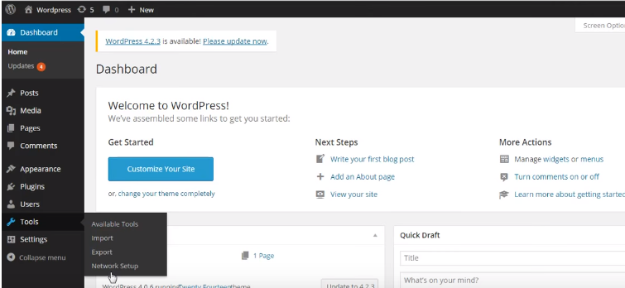

Slide 14
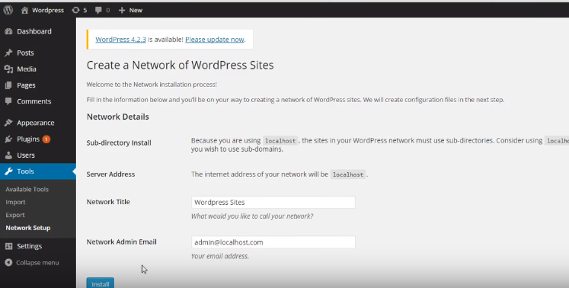

Slide 15
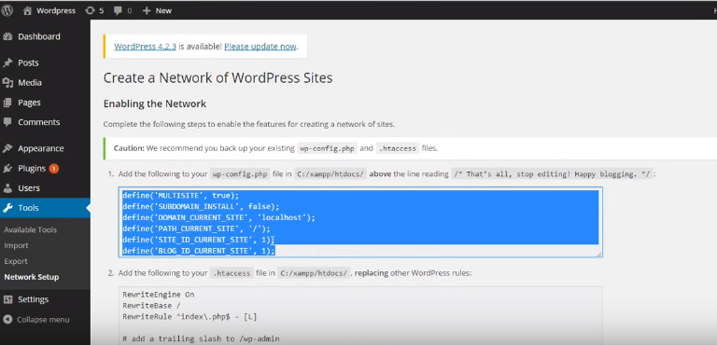
Copy the selected content in wp-confing file….
Paste after …….
Define(‘WP_ALLOW_MULTISITE’,true)

Slide 16
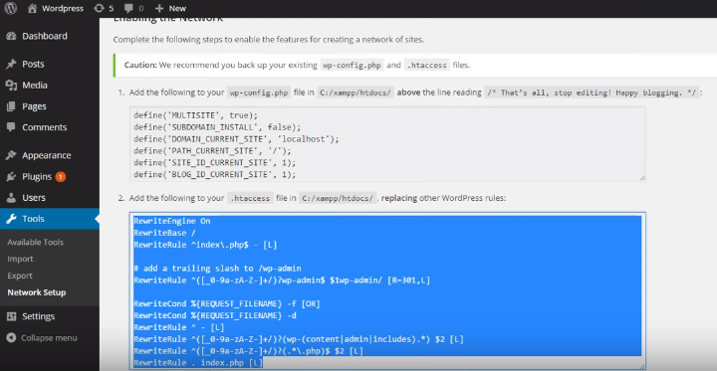
Delete all the content of .htaccess file….
Then Copy the selected content in .htaccess file….

Slide 17
How to add multiple websites in one wordpress
Then login with your USERNAME and PASSWORD.
After that get a multiple websites in your wordpress check it out.

